Slide 1
Meeting Your Special Education Needs at Otsego Northern Catskills BOCES
November 28, 2017
Mission Statement:
A BOCES providing world-class opportunities for the districts we represent.”

Slide 2
Providing Special Education is a Challenge
Providing Special Education is a Challenge
Regulation
Not many options
Cost (only receive high cost aid)
Surprise students

Slide 3
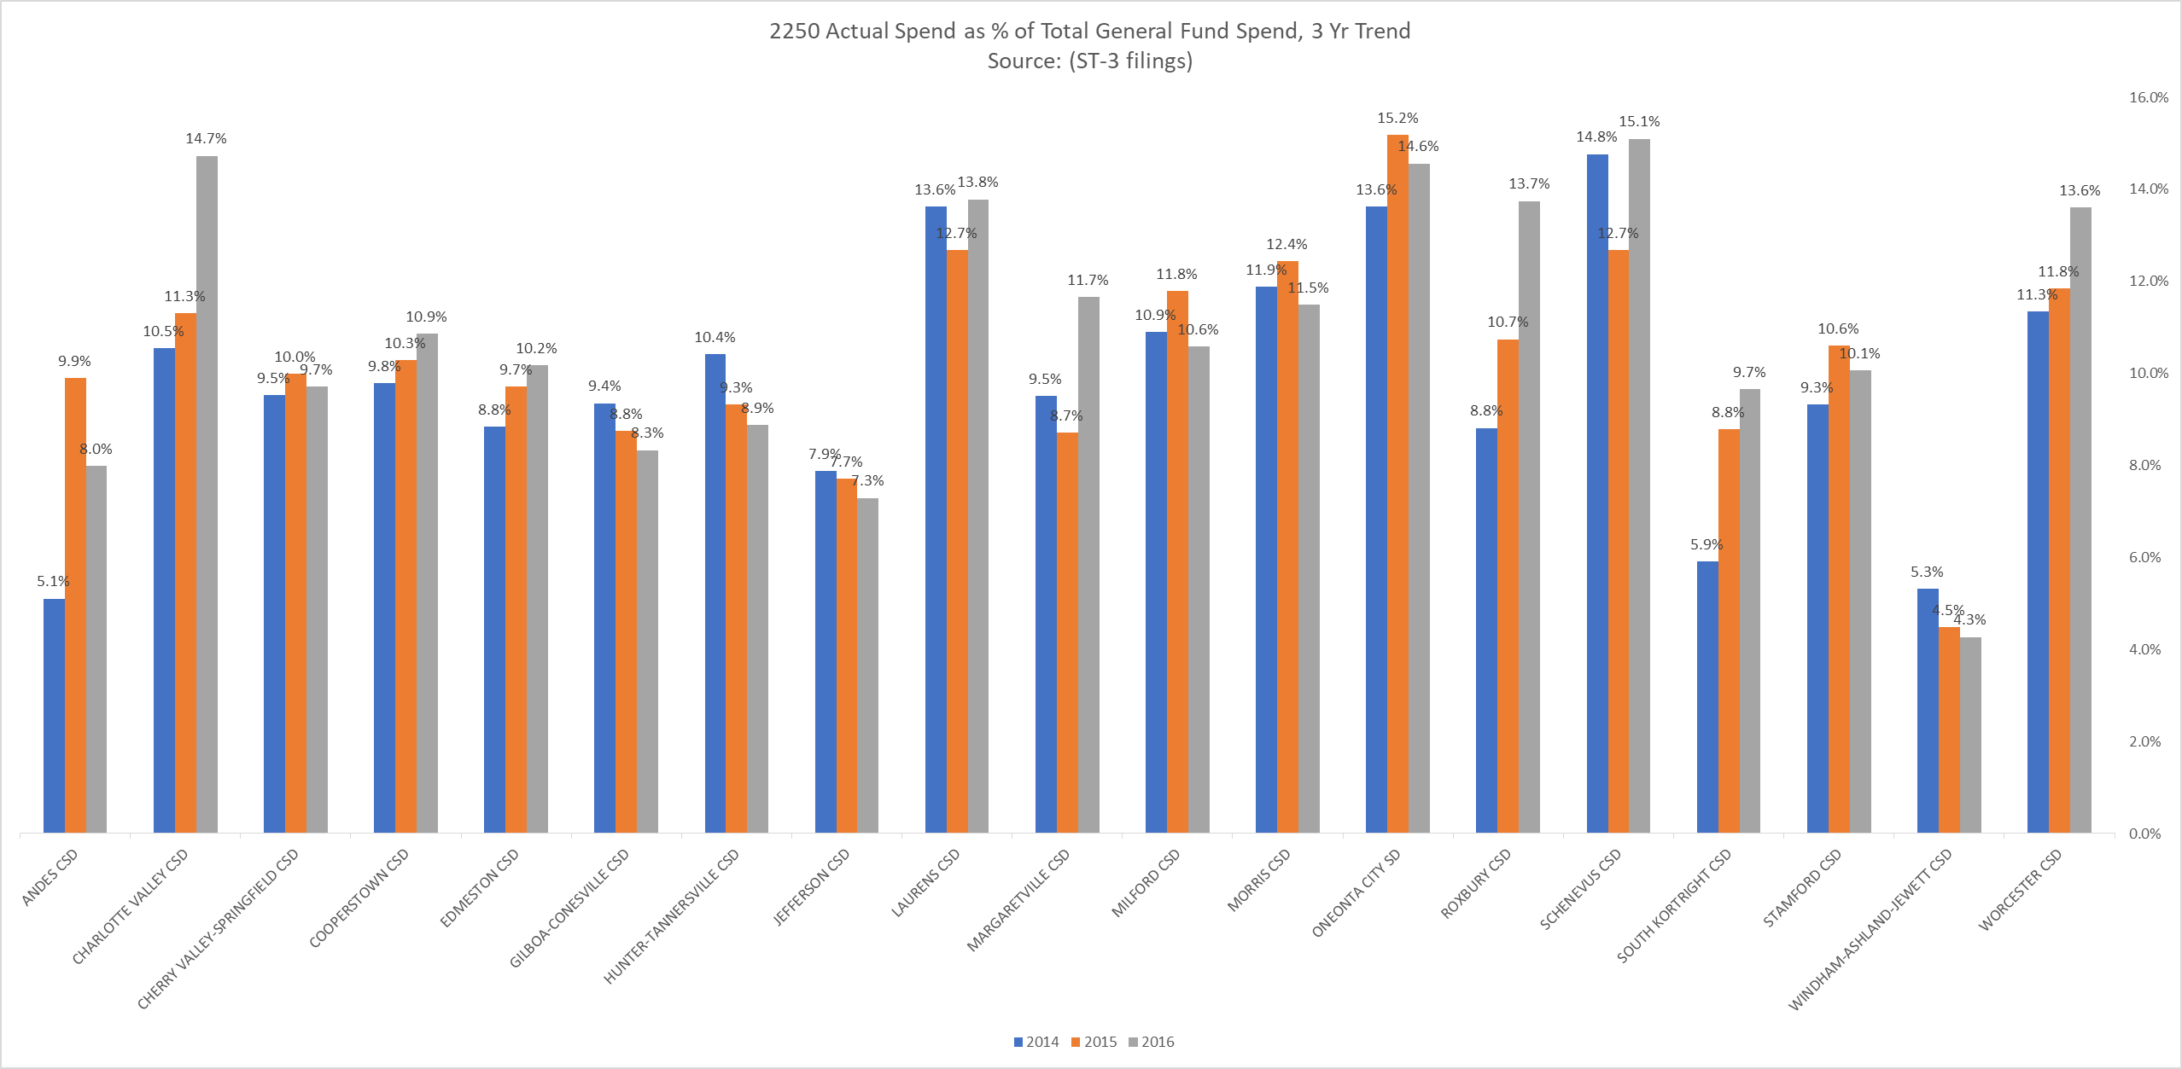
Special Education Costs - % of General Fund

Slide 4
Special Education Costs – Actual Spending

Slide 5
Total Spending on ONC Special Education Programs & Services (Final Contract Billing)

Slide 6
What is your Public Excess Cost Aid Ratio and Threshold?
 | 2016-17 PUBLIC EXCESS COST AID RATIO | 2016-17 THRESHOLD
ANDES | 0.250 | $92,646
CHARLOTTE VALLEY | 0.581 | $38,586
CHERRY VALLEY-SPRINGFIELD | 0.517 | $45,072
COOPERSTOWN | 0.277 | $40,539
EDMESTON | 0.673 | $36,147
GILBOA-CONESVILLE | 0.250 | $57,891
HUNTER-TANNERSVILLE | 0.250 | $63,129
JEFFERSON | 0.654 | $36,087
LAURENS | 0.709 | $35,808
MARGARETVILLE | 0.250 | $52,605
MILFORD | 0.626 | $40,782
MORRIS | 0.751 | $34,149
ONEONTA | 0.607 | $36,705
ROXBURY | 0.351 | $56,493
SCHENEVUS | 0.707 | $39,171
SOUTH KORTRIGHT | 0.552 | $43,122
STAMFORD | 0.565 | $44,853
WINDHAM-ASHLAND-JEWETT | 0.250 | $61,521
WORCESTER | 0.703 | $42,984

Slide 7
Providing Special Education is a Challenge
GOAL:
Provide a better understanding of BOCES programs and related services to assist districts with maximizing their high cost aid through the STAC process.

Slide 8
Agenda
BOCES Terminology
ONC BOCES Innovative Programs
ONC BOCES Related Services
ONC BOCES Billing and Final Cost Reports
STAC Reporting

Slide 9
BOCES Terminology
Special Education = Innovative Programs
CoSer – three digit # assigned by ONC BOCES for a specific program
CoSer is a cooperative service
200s – Special Education Programs
300s – Itinerants and Related Services
For each CoSer, can provide one or more services (example: sell by FTE and hourly)

Slide 10
BOCES Terminology
Firm Commitments or Final Service Requests
Contract with the BOCES (approved by Superintendent)
Hold district to Firm Commitments except for Special Ed Programs & Related Services – billed actual
Additional Service Requests (ASR)
Update to contract between BOCES and district (requires Superintendent approval)
Cross Contract
Contract with non-component district

Slide 11
BOCES Terminology
Invoicing
1/10th of annual cost billed monthly
September – June
Refund of Surplus
BOCES is not allowed to keep fund balance – must return to districts
OAOC = Otsego Area Occupational Center (OAOC)
NCOC = Northern Catskills Occupational Center (NCOC)

Slide 12
BOCES Terminology
MyWinCap – web based version of WinCap financial software used by BOCES
BOCES can only use WinCap (only software that can calculate BOCES aid)
All component districts have access to MyWinCap to enter preliminary and final service requests (commitments) and download monthly BOCES invoices.
Data Smart BOCES IEPDirect
Software used to track and report Special Ed students and related services (enrollment, billing, High Cost Amendment Report, SA-156
Reports provide detail for monthly billing (emailed to districts)

Slide 13
Innovative Programs
Jason Sanchez
Innovative Programs Administrator
Mission Statement:
A BOCES providing world-class opportunities for the districts we represent.”
Notes:
Good Morning and Welcome! I am delighted to have the opportunity to speak with you about Innovative Programs at ONC BOCES. Feel free to ask questions at any point during my presentation.

Slide 14
201 CoSer-Career Pathways
Vocational program for special needs students between the ages of 14 and 21 who are either at risk of dropping out or have been unsuccessful in traditional academic or vocational classes
Career Pathways 1 and 2
Involved in a variety of career modules that will provide pre-vocational training, critical thinking skills, job training, and other fundamental life skills
Career Pathways 3 and 4
Half-day job training placement in the community.
Job Coaches provide support and supervision
Service includes Crisis Counseling, Access to Dean of Students and Crisis Intervention Specialist
IEP counseling billed separately
Notes:
Our Career Pathways program is a pre-vocational program for special needs students. We serve students ages 14-21. Career Pathways 1 and 2 provide the foundation of our program where students learn about a variety of career modules while also learning about the soft skills employers are looking for. For example, the students recently spent time learning about the importance of good hygiene. After completed the first two years, students either go to a CTE program or continue on to Career Pathways 3 and 4. This program continues to focus on employability skills while also providing students with a job training placement in the community Monday through Thursday. On Friday, the students run a Café, where they take orders, make the food, and deliver the food. As part of this service, students have access to crisis counseling, the dean of students and the crisis intervention specialist. IEP counseling is billed separately. Students have the opportunity to earn work based learning hours through this CoSer.

Slide 15
201 CoSer-Career Pathways
Career Pathways 1 and 2 are offered at OAOC and NCOC
Career Pathways 3 and 4 are offered at OAOC
Career Pathways 3 and 4 at NCOC beginning in 2018-2019
Notes:
We offer CP 1 and 2 at both Occupational Centers. CP 3 and 4 is currently offered at OAOC, with plans to open a CP 3 and 4 class at NCOC beginning in 2018-2019, pending sufficient enrollment.

Slide 16
202 CoSer Therapeutic Learning Center
The TLC helps special needs children who are experiencing severe emotional crises by identifying and addressing related problems at home, at school, and in the community
It also assists students to make a stable transition from hospitalization or other placement to the community and home school district
Service Includes IEP Counseling, Crisis Counseling, Access to Dean of Students and Crisis Intervention Specialist
Notes:
Students in our TLC program have a variety of needs. They are referred through the CSE for placement in this temporary evaluative program. They are often experiencing severe emotional crises leading to disruptions at home and school. We also have students who are transitioning from hospitalization related to mental health issues. This program offers students a stable environment where we focus primarily on emotional and social stability. This CoSer includes 2 sessions of IEP counseling per week, crisis counseling and access to the dean of students and crisis intervention specialist.

Slide 17
202 CoSer Therapeutic Learning Center
30-45 Day Evaluative Program @ OAOC
Dr. Bercovitz completes Neuropsychological testing
Teacher completes academic testing
Counselor completes social and emotional survey
Elementary and MS/HS Classes
Report sent to district
Notes:
Dr. Bercovitz completes a neuropsych, the teacher completes academic testing, the counselor completes a social and emotional survey. At the completion of the evaluation, a report is generated and at a CSE meeting with the parent or guardian, our team presents the findings and recommends levels of support.

Slide 18
204 CoSer-Basic Life Skills
12:1:1 Program
½ day program paired with Career Pathways for a full day
Academic Program for students with limited communication skills and severe learning difficulties
Students are provided with access to regents level standards
Some students identified as being eligible for alternative assessment
Learning activities are designed to include practical applications in daily life
Notes:
This CoSer is provided to compliment Career Pathways with traditional academic courses. We have students who are working towards a local or regents diploma as well as students who are eligible for alternative assessments. The teacher provides the student access to regents level standards for those on a regents track. Learning activities are also designed to include practical applications in daily life.

Slide 19
210 CoSer-TRUST
This program is a service-intensive model for students with severe behavioral and/or social/emotional difficulties. Additional features include:
On-site counseling
Highly structured learning environment
Intensive behavior management
Inclusion in regular education classes per each student’s IEP
Service Includes IEP Counseling, Crisis Counseling, Access to Dean of Students and Crisis Intervention Specialist
Notes:
Our Trust CoSer is our most restrictive academic class. Students in this program have severe behavioral and social emotional difficulties. We offer on site counseling, a highly structured learning environment, and intense behavior management. This CoSer includes IEP Counseling 2 times weekly, crisis counseling as needed, access to the dean of students and crisis intervention specialist. Students in this program are primarily working towards a local or regents diploma.

Slide 20
210 CoSer-TRUST
Classes @ OAOC
2 Elementary (Grades 1-4 and Grades 5-6)
1 Middle School (Grades 7-8)
2 High School (Grade 9 and Grades 10-12)
Expansion
Anticipate opening two additional classes which will be located at NCOC in Grand Gorge
Notes:
In the last year we have expanded from 3-5 classes, and we are anticipating two additional classes will be opened and located at NCOC in Grand Gorge.

Slide 21
212 CoSer- Behavior Adjustment
This 8:1:1 program provides educational experiences for the student with minimal learning problems and moderate behavioral and/or social/emotional difficulties
Elementary, middle and high school students are instructed with appropriate mainstreaming opportunities provided in regular education classes per each student’s IEP.
Secondary students ages 14 to 21 have the option to combine their academic classes with CTE classes or Career Pathways both of which are located at the Occupational Centers in Milford and Grand Gorge
IEP counseling is billed separately, Crisis counseling is included
Notes:
Our 212 CoSer is for students with minimal learning problems and moderate behavioral and social emotional needs. When appropriate, students have the opportunity to mainstream in general education classes(Charlotte Valley, Alt Ed) Secondary students have the option to combine their academic classes with CTE classes in 11th and 12th grade, or Career Pathways in grades 9-12. IEP counseling is billed separately but crisis counseling is included in the tuition.

Slide 22
212 CoSer- Behavior Adjustment
Charlotte Valley (Grades 4-6)
OAOC (9-12)
NCOC (9-12)

Slide 23
308-School Counselor/Students with Disabilities Counseling
Can be purchased as an FTE
Can be purchased as an hourly FTE for IEP Counseling
IEP Counseling is included in the tuition for students in TLC and Trust programs
Crisis Counseling is included in the tuition for students in TLC, Trust, BA, BLS, and CP programs
Notes:
See Slide

Slide 24
104-Consultant Teaching Services
Students in CTE Programs and Alternative Education
Minutes determined per IEP
Best Practice Model for providing support for students with disabilities in CTE programs

Slide 25
2017-2018 Innovative Programs Tuition/Rates
201 Career Pathways $18,841
202 TLC $345 per day
204 BLS $49,023
210 Trust $49,949
212 BA $61,224
104 Consultant Teacher $59.83/ hr
1:1 Aide $48,749
308 IEP Counseling $122/hr
308 School Counselor $9,765/FTE

Slide 26
Firm Commitments
After Firm Commitments are finalized in the spring, adjustments are made to balance the budget
Student Services Requests are matched with firm commitments
Adjustments to the budget are made based on firm commitments
Superintendents’ Advisory Committee makes final recommendations

Slide 27
Registration Process-Annual Reviews
Districts submit Student Service Request to Innovative Programs Office along with Application and accompanying documentation such as transcript, immunizations, IEP

Slide 28
Registration Process-School Year
District CSE contacts Innovative Programs Administrator to determine availability of programs and discuss class profile
CSE convenes and may recommend a BOCES program
CSE chair, Innovative Programs Administrator, and Parent discuss a visit to the program if appropriate
Districts submit Student Service Request to Innovative Programs Office along with application and accompanying documentation such as transcript, immunizations, IEP
CSE chair, Innovative Programs Administrator, and Parent discuss start date
Additional Service Request is completed by Innovative Programs Office and sent to district for Superintendent approval

Slide 29
Billing
Districts are billed on Firm Commitments for first billing period
Adjustments are made for October billing and each billing thereafter if changes to programs and services are requested
Monthly billing reports are sent to Business Officials

Slide 30
Communication
Dean of Students contacts districts for disciplinary issues and to provide updates on students and their progress in program
School Counselors and Teachers contact CSE chairs for updates on behavior and academic progress
Innovative Programs Administrator contacts CSE chairs regarding any recommended change in the level of support
Change in Program
Need for 1:1 Aide

Slide 31
Questions?

Slide 32
What are Itinerant/Related Services at ONC BOCES?
ONC BOCES hires and assigns Itinerant teachers of academics, the arts and student support areas, as well as related service providers to schools that do not generate a student population sufficient to justify a full-time position. Itinerant teachers and related service providers work with the general education population and with students who have disabilities. Every effort is made to hire certified teachers and licensed providers in each discipline and therapy area. Listed below are current areas in which itinerants and related service providers are hired.
Mission Statement:
A BOCES providing world-class opportunities for the districts we represent.”

Slide 33
Challenges in regards to Itinerant Services
Itinerant Staff include: Certified PE/Health, Art, Foreign Language, ELL teachers, Library Media Specialist, Science Enrichment Program and Licensed Physical Therapists, Occupational Therapists, Speech Teachers, Visually Impaired Teacher, Hearing Impaired Teacher, Assistive Technology
These staff members have to fit the recommended amount of time requested for student therapies, as required by their Individualized Educational Plans (IEP) and classes needed by the districts into their schedules, while including their travel time, their planning time and their required lunch and breaks
Itinerant Staff need to have Masters Degrees (or higher) and continue their education in order to keep their licenses and certification for NYS

Slide 34
Which Itinerant/Related Services are available for the 2017-18 School Year?
CO-SER 301 PHYSICAL EDUCATION Regular Education/Special Education $10,043 per .1 FTE
CO-SER 302 ADAPTIVE PHYSICAL EDUCATION Special Education $10,043 per .1 FTE
CO-SER 304 FOREIGN LANGUAGE Regular Education/Special Education $12,279 per .1 FTE
CO-SER 305 SPEECH IMPROVEMENT Regular Education/Special Education $12,037 per .1 FTE/$136 hr
CO-SER 315 SPEECH/LANGUAGE, SEVERE Special Education $12,037 per .1 FTE/$136 hr
CO-SER 306 ART Regular Education/Special Education $11,903 per .1 FTE
CO-SER 309 HEALTH Regular Education $11,091 per .1 FTE

Slide 35
Itinerant Services available for 2017-18 School Year (continued)
CO-SER 310 SCHOOL PSYCHOLOGISTS Regular Education/Special Education $11,255 per .1 FTE
CO-SER 314 SCHOOL LIBRARY MEDIA SPECIALIST Regular Education/Special Education $ 9,544 per .1 FTE
CO-SER 318 ENGLISH LANGUAGE LEARNER (ELL) Regular Education/Special Education $12,417 per .1 FTE
CO-SER 320 SERVICE FOR THE VISUALLY IMPAIRED Regular Education/Special Education $206 per hour
CO-SER 321 SERVICE FOR THE HEARING IMPAIRED Regular Education/Special Education $218 per hour
CO-SER 328 PHYSICAL THERAPY Special Education $185 per hour
CO-SER 329 OCCUPATIONAL THERAPY Special Education $136 per hour
CO-SER 504 ELEMENTARY SCIENCE PROGRAM Regular Education/Special Education $12,320 per .1 FTE

Slide 36
Process for Requesting Itinerant/Related Services
If you have a need for an Itinerant Certified Teacher, such as PE, Art, Library Media Services, ELL, Foreign Language sometime throughout the school year, you should call Robin Robbins or email her and talk to her about your needs (i.e. FTE, location, etc.)
By firm commitment time in the spring, you should decide what you need for Itinerant Teacher and Related Services for the next school year and place that FTE amount for that CoSer into WinCap (the budgeting/purchasing software used by BOCES & other districts)
For Related Service needs;
If the student needs an evaluation to see if they need a specific service, send the signed permission form (found on the BOCES website) to Cassandra Bruno at NCOC – cbruno@oncboces.org. She will then send it to the correct teacher/therapist and they will set up the observation time with the student’s CSE chair. An evaluation costs the district $350/evaluation

Slide 37
Process for Requesting Itinerant/Related Services (continued)
If the student already has an IEP with a recommended therapy and frequency, the CSE chair should send a Student Service Request Form (SSR) (found on the BOCES website) to Cassandra Bruno at NCOC – cbruno@oncboces.org. She will then send an email to the correct teacher/therapist and find out if they can fit the student and frequency requested in to their schedule. Robin Robbins will oversee this process and stay in communication with all stakeholders involved.
Additional Service Request Forms (ASR) will be sent to the district if the requests for Related Services comes in after the firm commitments have already been made by the district and will then need the Superintendent’s signature letting us know that everyone is in agreement.
Cross Contracts (CC) will be sent to the district(s) who are not a component district within the ONC BOCES and again, the Superintendent from that district will need to sign and return to the District Superintendent of ONC BOCES before services can be provided to the student.

Slide 38
Funding Methodology for Calculating FTE Costs
The FTE billing methodology has been used since January 2017 and it represents an equitable distribution of travel, planning periods and lunch breaks between districts who are purchasing those services.
Related services are not included in the costs of tuition for the IP programs – they are therefore billed separately
The billing methodology is as follows:
Three classes/periods/sessions in the same day = .1 FTE
Two or less classes/periods/sessions in the same day = .05 FTE
Four or more classes are calculated by adding the .1 FTE, plus each .05 FTE amount of time

Slide 39
Questions ?

Slide 40
Billing and Reporting
Mission Statement:
A BOCES providing world-class opportunities for the districts we represent.”

Slide 41
Billing & Reporting
Tuition Calculations
Billing Procedures
Refund of Surplus
High Cost Amendment Report

Slide 42
Tuition Calculations
Budget Development Process
Timeline
Major Assumptions
Salary & Benefits
Participation
Billing/cost sharing methodologies
Firm Commitment Challenges

Slide 43
Budget Development Timeline

Slide 44
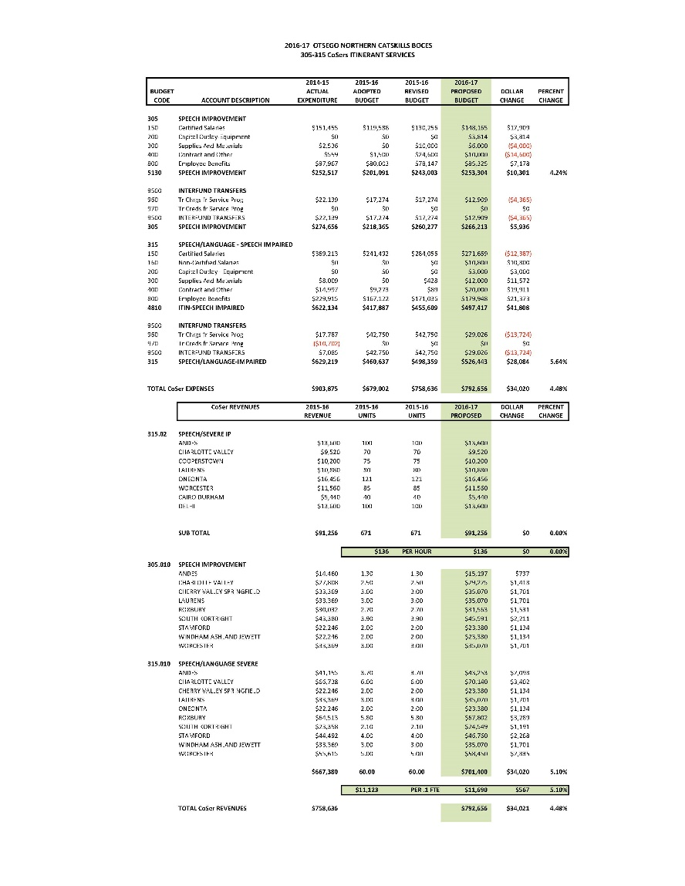
Budget Presentation Sheets

Slide 45
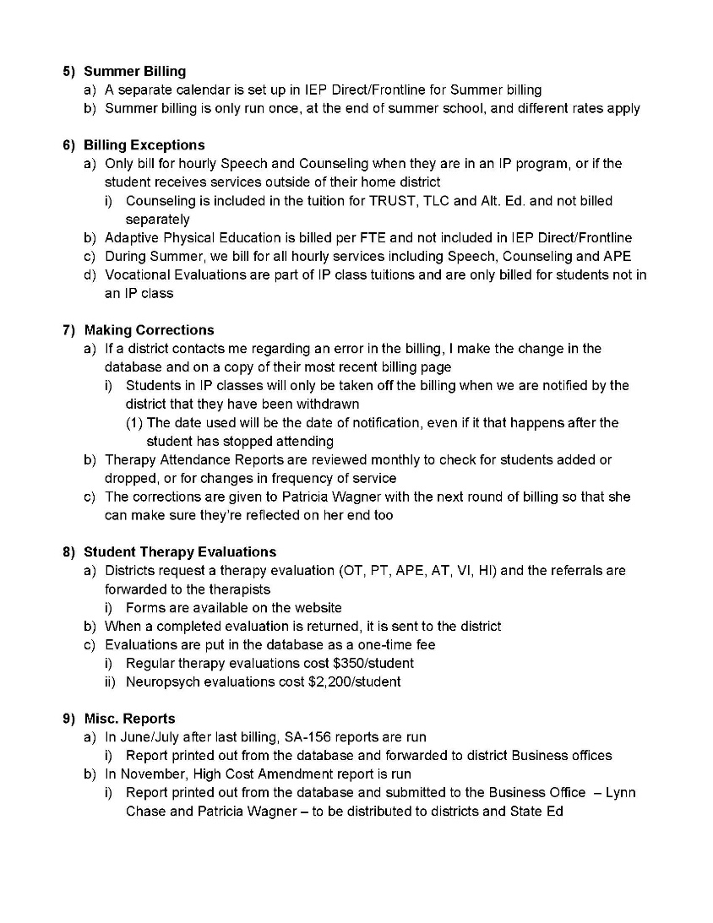
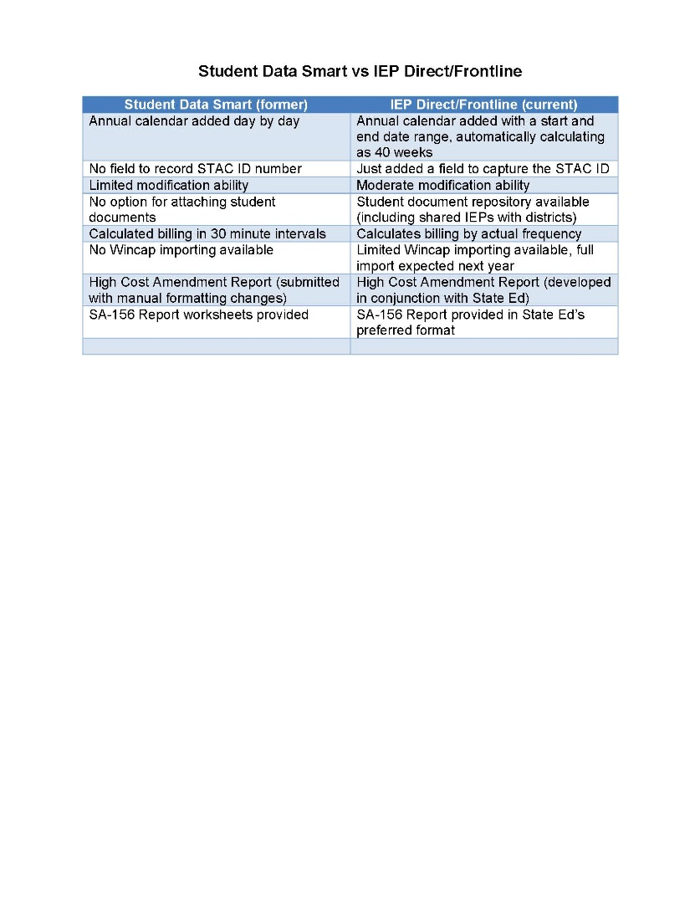
Billing Procedures

Slide 46
Contract Invoice

Slide 47
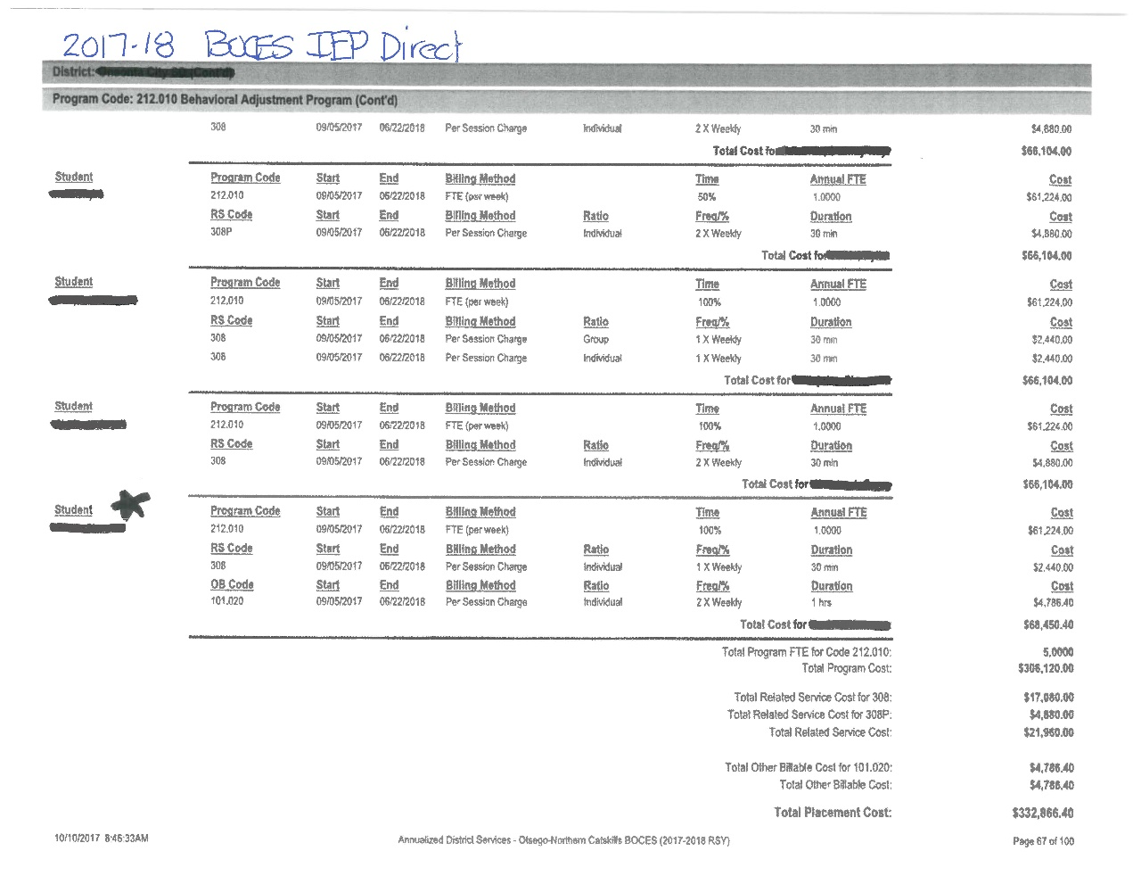
Contract Invoice - Detail

Slide 48
Refund of Surplus for Special Ed Programs & Services

Slide 49
High Cost Amendment Report

Slide 50
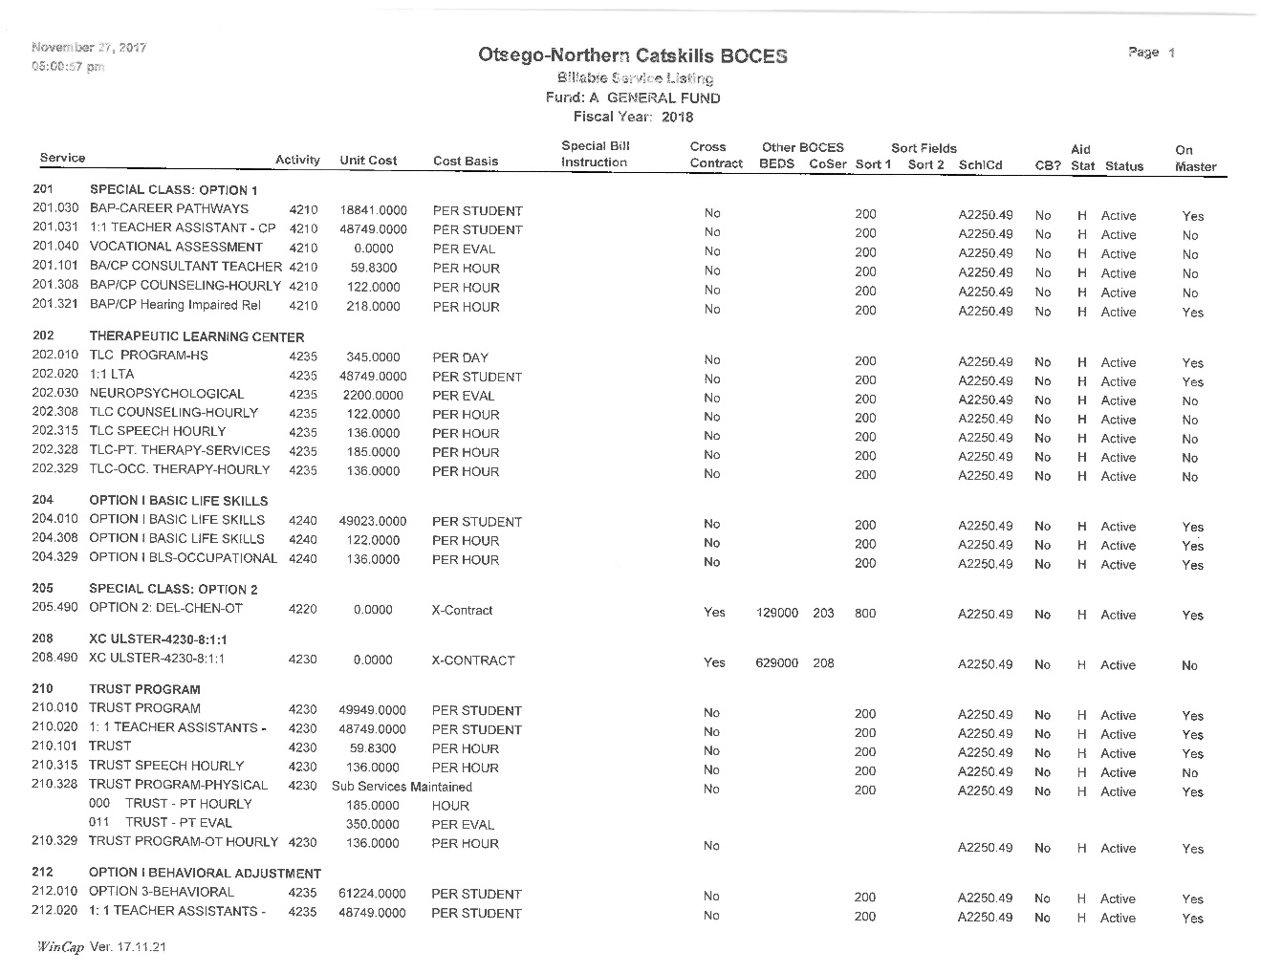
Special Ed Service Listing

Slide 51
Summary
Service Listing – can STAC these services for High Cost Aid
Invoices @ tuition amounts (Sept – June)
Important: Verify students on monthly invoices (Business Official, CSE Chair)
High Cost Amendment Report @ actual cost (December)
Return of Surplus (by December)

Slide 52
Questions?
Contact Information:
Jason Sanchez
Innovative Programs Administrator
(607) 286-7715 ext. 2103
jsanchez@oncboces.org
Robin Robbins
Itinerant Services Supervisor
(607) 286-7715 ext. 2147
rrobbins@oncboces.org
Lynn Chase
Director of Management Services
(607) 588-6291 ext. 2172
lchase@oncboces.org

